Slide 1
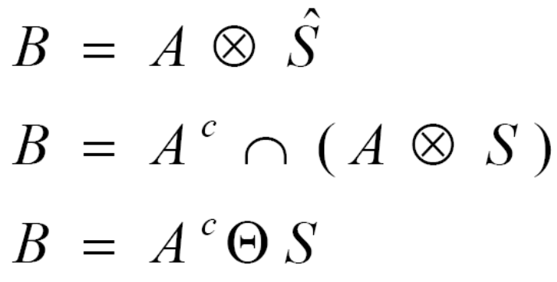
Question 1
3 points
02-12-2010
Quiz#4
Given the image A and structuring element S, compute the following:
0 | 0 | 0 | 0 | 0 | 0
0 | 0 | 1 | 1 | 1 | 0
0 | 1 | 0 | 0 | 1 | 0
0 | 1 | 1 | 1 | 1 | 0
0 | 0 | 1 | 1 | 1 | 0
0 | 0 | 0 | 0 | 0 | 0
X | X | X
1 | 1 | 1
X | 0 | X
S
A
Represent the following images in form of sets:
Question 2
4 points
Question 3
3 points
0 | 0 | 0 | 0 | 0 | 0
0 | 1 | 1 | 1 | 1 | 0
0 | 1 | 0 | 0 | 1 | 0
0 | 1 | 0 | 0 | 1 | 0
0 | 1 | 1 | 1 | 1 | 0
0 | 0 | 0 | 0 | 0 | 0
Apply region filling algorithm to the image ‘a’ in question 2 and show the images from starting up to convergence.
50 | 150 | 50
125 | 1 | 200
0 | 250 | 0
a
b

